Slide 1
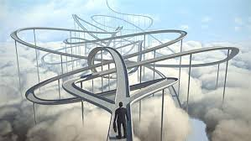
Paths To Transcendence
By John Bohan

Slide 2
Paths To Transcendence
Acknowledgements
I want to acknowledge the following for help, editing and inspiration:
The Gone Beyond Star Group Franza, Russell, Zelda and Greg; Kate Hines, Val Norman and Ken Malik

Slide 3
Paths To Transcendence
Forward
The following Power Point is based on personal experience, research, and speculation.
Are the conclusions, facts, and theories likely to be modified or changed?
Yes. In fact some will likely be found untrue.
However, in this NOW, many of us seem to be going thru a quantum leap in our view of reality.
This view could lead to new procedures for health and adjustments in our life goals.
Quantum Physics seems to be confirming the views held by many religions that our views of reality based on forms (material objects) is a projection of consciousness.
That the real reality is an electro / magnetic energy field which we can manipulate thru our consciousness to become forms.

Slide 4
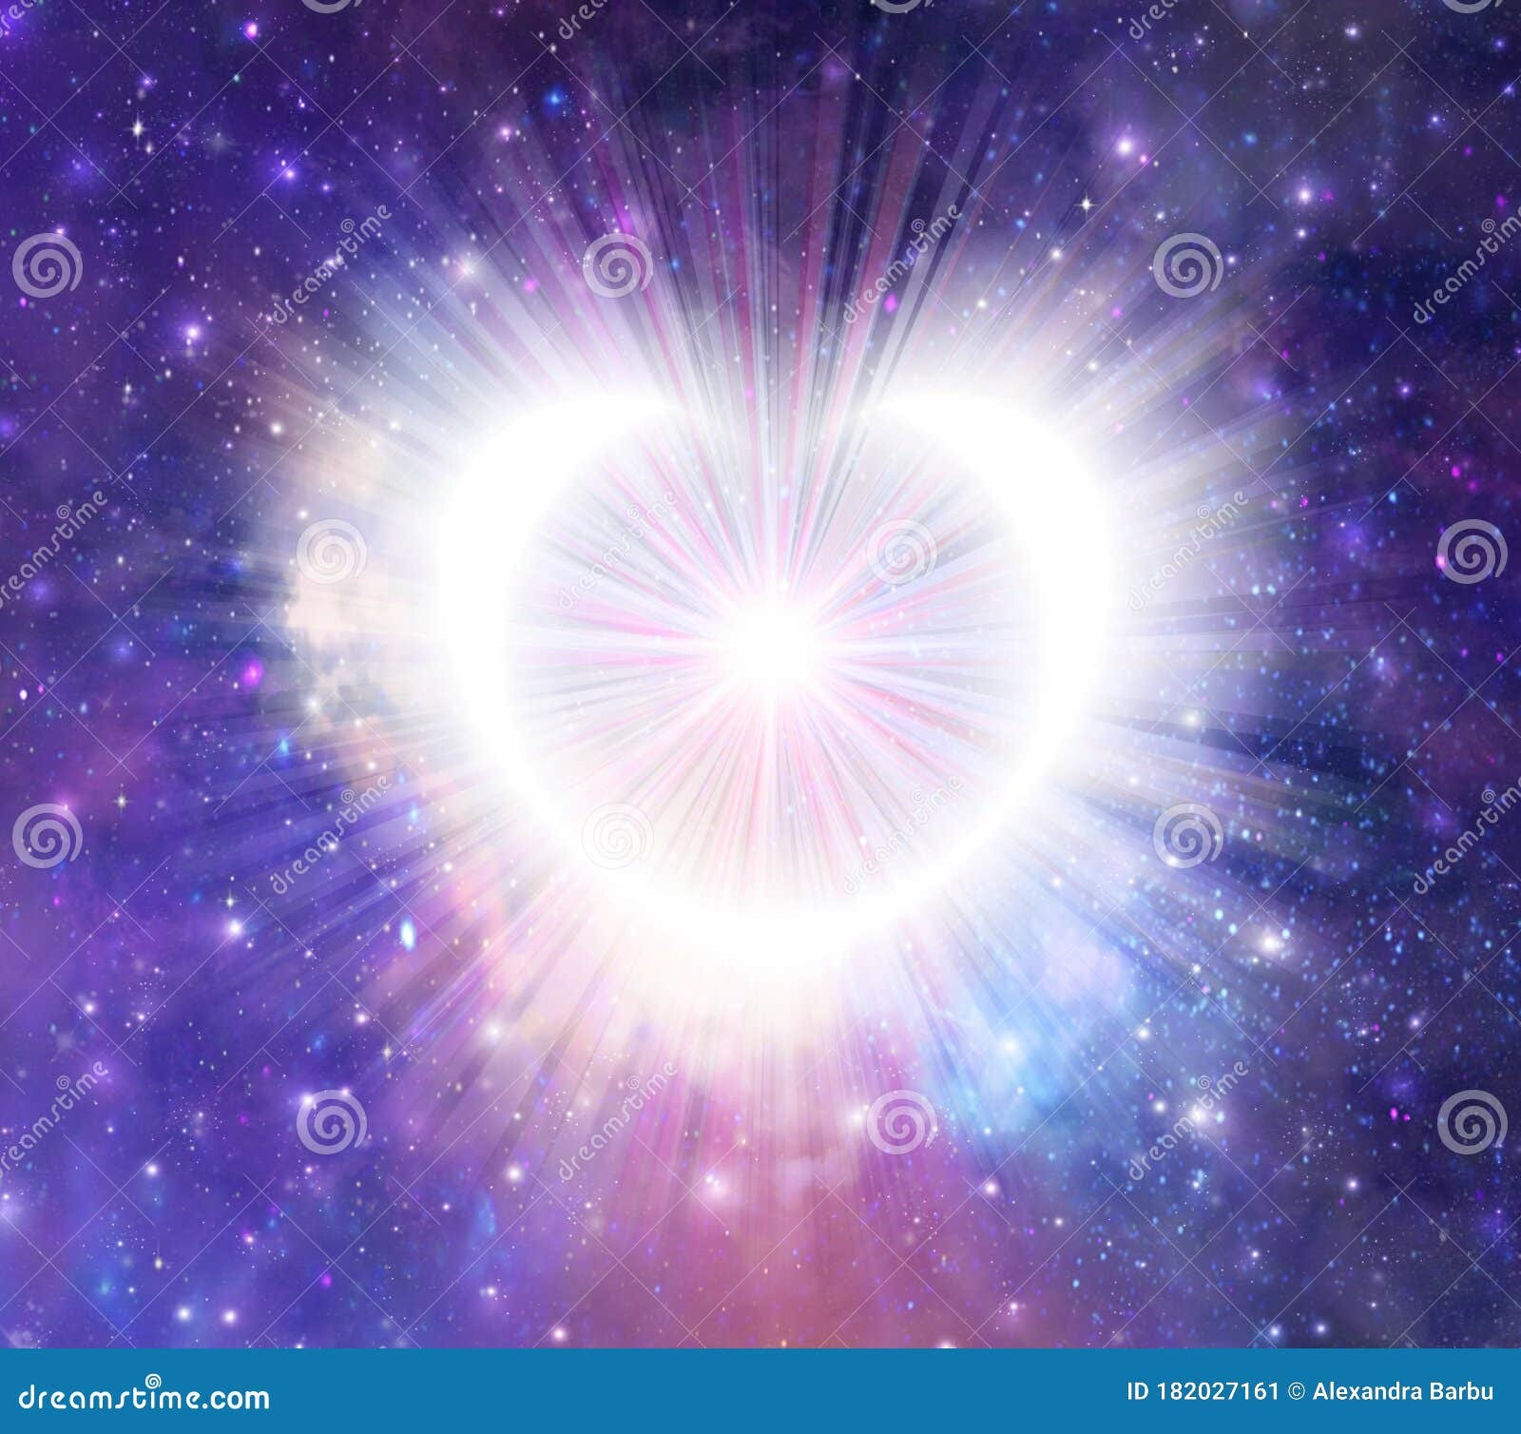
Paths To Transcendence

Slide 5
Paths To Transcendence
I feel a calling to pursue and share the following with you.
Perhaps, like the Tibetans, you will be:
Heart Sutra
Gone Gone, Gate Gate,
Gone Beyond, Para Gate,
Gone Beyond the Beyond, Para Sum Gate
Hail the Traveler Bodhi Swaha

Slide 6

Paths To Transcendence
Surrender to the Journey

Slide 7
Paths To Transcendence
Chapters
Meditation – Relax, focus
Physics – Energy, matter
Chakras – Body’s energy centers
Healing – Energy Balance, low stress
Emotions – Energy frequency
Consciousness – Awareness
Lucidity OBE NDE – Out of Body Experience, Near Death Experience
Transition – Beyond life
Samadhi – Enlightenment
Mahamudra – Buddhist Enlightenment
Conclusion

Slide 8
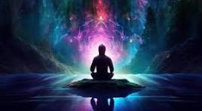
Meditation
Om Mani Padme Hum

Slide 9
Meditation
Be here now
Relax, focus, lower stress, become aware – A good place to start your journey.
Meditation is not a put down. If you are aware your mind is wandering you are meditating.
It is a higher level of consciousness to be aware the mind is wandering than to be caught up in the wander.
Vipassana – Insight meditation where one watches the breath rising and falling.
Mantra chanting – Sounds to promote relaxation, enlightenment, healing, etc.
Staying in the “now” – present. Not past or future
Tibetan Buddhism – Monks sitting in caves in isolation for 3 years meditating, found answers.
Star Group – Small group meditation focusing on group goal i.e. health. Enlightenment, etc.

Slide 10
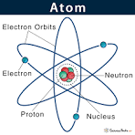
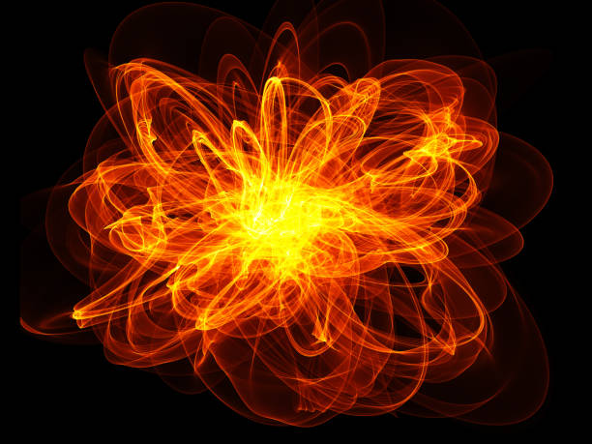
Physics
thoughts are things
Quantum Physics
Newtonian Physics

Slide 11

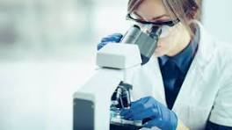

We create our own reality
energy
atom
matter
observation

Slide 12
Modern physics including quantum physics has changed our basic view of reality.
As Einstein pointed out there is a direct mathematical relationship between matter and energy. E=MC 2
We now know that atoms, the basic element of matter, is not solid and the basic parts go back and forth between waves and matter. In fact, most of an atom is empty space.(3,6)
So when are these parts of an atom solid matter? (When observed) Otherwise atoms are composed of waves (energy)
This has led some scientists and others to conclude that what we think of as our world of solid objects i.e. matter is actually a projection of aware consciousness i.e. observation.(3,4)
In eastern traditions and now with some scientists, it is thought that the body is electro/magnetic energy. This energy is often thought to surround the being in the form of an Aura.
Many believe the electro / magnetic field is one big connection beyond time and space.

Slide 13
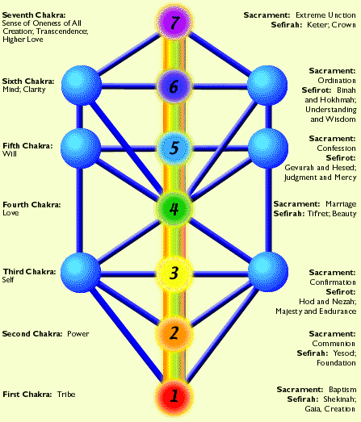
Chakras
This table compares:
The seven Chakras. (1,11)
the Seven Sacraments in Christianity
The Jewish Tree of life from the Kabala

Slide 14
Chakras
The chakras are 7 energy centers in the human body.
Each chakra has its own individual emotional and spiritual benefits. They are, in so many ways, associated with happiness, creativity, self-confidence, love, self-expression, vision and connection with the higher self and your spirituality.(10)
Lower 3 chakras are related to the material plane.(1,5)
Upper four chakras are related to spiritual development.(5)
By energizing the Chakras one can enhance health, increase psychic abilities, and raise your Kundalini power.
Kundalini - coiled like a snake at the base of our spine, is an energy force that lies dormant until activated through spiritual practice. Awakened, the coiled creative life force that rises from the base of our spine releases energy to lift consciousness. It also heals the body, soothes stress, and encourages peace.(14)
This energy may cause physical sensations like tingling, shaking, or heat. Secondly, they may begin to experience powerful emotions and thoughts that they previously suppressed.

Slide 15
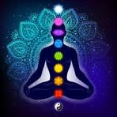
Chakras
7th Chakra Crown – Bliss, Higher Love,
Golden, Grace, connection to divine
6th chakra Third Eye – AUM, Mind, Joy, White, Intuition, Wisdom
Whatever happens to you in life was meant to be
5th Chakra Throat – Ah, Red, Will, Truth,
verbal communication
4th Chakra Heart - Hum, Love, Blue, Gratitude, compassion, forgiveness,
Primary emotional energy center of body
3rd chakra Solar Plexus – Self, inner power, Green, fulfillment, happiness, intuition, connection to others
2nd Chakra Sacral – Yellow, energy and creativity, occupation, sexuality, power, money, live honorably, fear of change
1st Chakra Root – Origin, brown, connection to the earth, Power of emotions, Tribal membership, “eye for an eye” justice

Slide 16
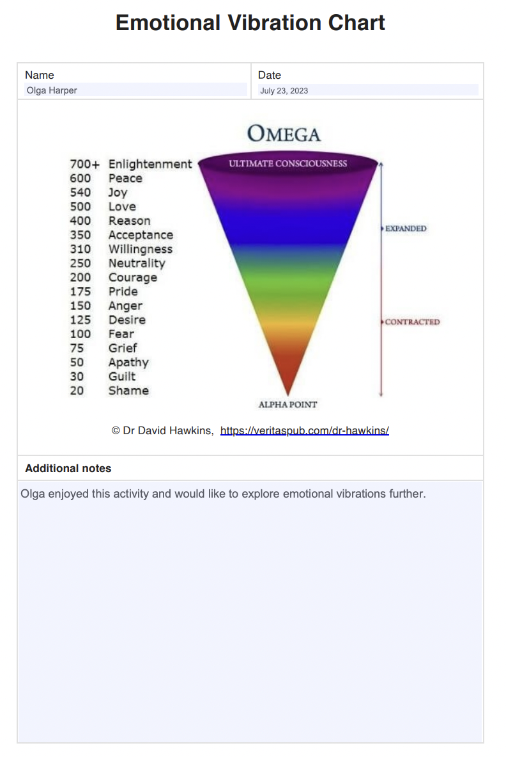
Emotions are energy fields that can be measured and used to raise consciousness.(4)
Each emotion has a frequency.(4)

Slide 17

Emotions
follow self not others
Emotions are connected to health.(1,4,5,11)
Low frequency emotions, such as hate, anger, fear, etc. keep one on lower levels of consciousness and poorer health.
Higher frequency emotions, such as Joy, bliss, love, Peace, etc. are related to higher consciousness and better health.(see Despenza for clarification of the above 4)
We are brought up to believe our emotions are the result of actions outside ourselves.(7)
Emotions come from inside of you, not from others or outside events. Consequently, we have control over our emotions.(7)

Slide 18
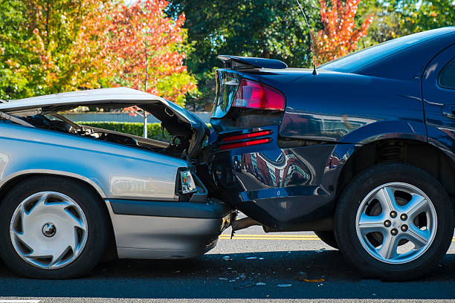
Emotions
Imagine someone rear ends you.
You have the choice of being:
angry,
frightened,
no emotion,
sorry for this person who made this mistake.
They could have a medical emergency or not have seen you or be an unreasonable jerk - who knows?
In this situation you can choose your emotion.

Slide 19
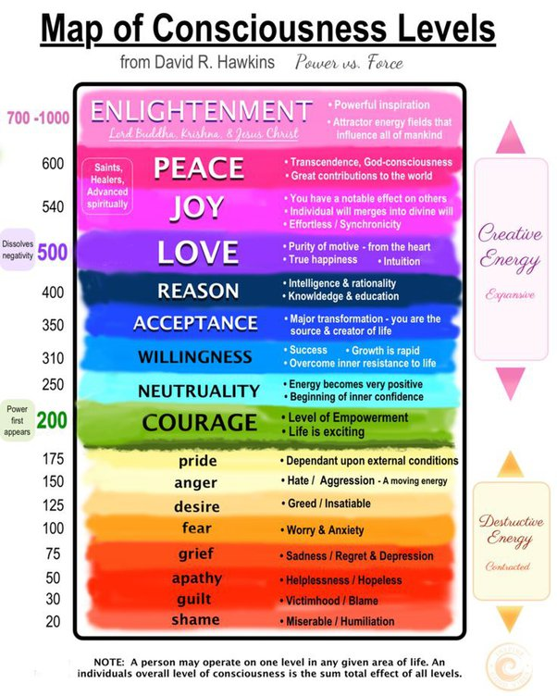
At right we se graphically displayed the relationship between electro / magnetic frequency and emotional states

Slide 20
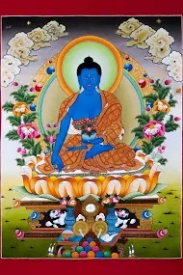
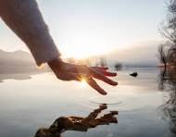
Healing
trust change
Green Tara
Medicine
Buddha
Om Tara
Tu Tara Tu Re
Soha
TA YA THA / OM
BEKANDZE BEKANDZE /
MAHA BEKANDZE
RANDZA /
SAMUDGATE SOHA

Slide 21
Healing
Music, including chanting, has been used to heal since before recorded time.
Breathing techniques are popular for healing.
A modern form of healing music, as championed by The Monroe Institute, is Hemisync. Recorded sounds designed to bring the brain’s hemispheres together. (6)
By energizing the Chakras with high frequency energy emotions, one can heal. (1,4)
Reiki is an energy healing technique in which a Reiki master (who has undergone formal training in this healing art) uses gentle hand movements with the intention to guide the flow of healthy energy (what's known in Reiki as life force energy) through the client's body to reduce stress and promote healing.(2,5)
Mild electro/magnetic shock is being used to heal.(13)
Healing modes that touch on Electro / magnetic fields include Chiropractics, Acupuncture, Reiki, Tai Chi, Yoga, and Meditation.
As Caroline Myss points out: (1)
Healing can be unattractive if your life connections depend on your illness.
Forgive and let go to heal yourself.
We create our own disease.

Slide 22
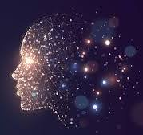
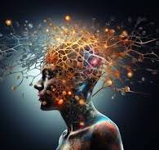
CONSCIOUSNESS
Awareness - The fact that you are aware that you are alive.
Creator of forms through observation. (3,4,10,12)
Collective consciousness – The electro / magnetic connection between all. (beyond space and time)
Consciousness maps : Tree of Life, Chakras, Tarot
Raising consciousness:
Being in the now – present (beyond time)
Being in the higher emotions – Love, Bliss, Joy (4,5,10)
Empowering the upper Chakras – 4 thru 7
“The seer behind the doer”

Slide 23
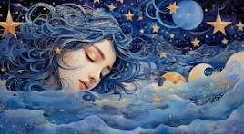

Lucidity
OBE Out of Body Experience
NDE Near Death Experience
In the dream state one can enter other dimensions including Lucid states.
Lucid states are in color and highly defined. These dreams can be thought of as highly significant.
Some believe Lucid dreams are out of body experiences.(OBE)
Many have reported entering different states of consciousness during near death experiences (NDE) (8,9).
Still others claim they can leave their body at will in an astral form (OBE).(10)
Many believe dream states are as real as waking states. Therefore, one should treat the dream states as defining reality on an equal footing with waking states.(11)
Using the positive affirmations such as: “I remember my dreams”. Or “I have lucid dreams”. As well as Chronicling your dreams, can bring about an awareness of the dream world into the awake world.(10)

Slide 24
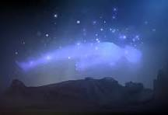
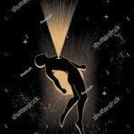
Transition
Body Spirit
Form Energy
Whether it be heaven, hell, nirvana, projection of your consciousness, most people on the planet believe there is some kind of existence after transition (death).
The Hindus, Christians, Moslems and Buddhists believe one can achieve states of enlightenment that enhance the transition between human life and the astral state.
Past lives are a common belief to many religions which supposes a transition from human life to the spirit body and then on to another human body.
If one believes we are really electro / magnetic beings beyond time and space, then it’s a small jump to imagine our existence does not depend on the human form.
However, do we have a conscious awareness of individuality in the astral form?
Many of those who have had OBE (Out of Body) and, or NDE (Near Death experience) would argue that there is a dimension where you are not in the body but do have an awareness of your individuality. (8, 9, 10)

Slide 25
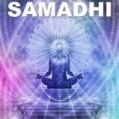
Samadhi
That Place
Beyond Time and Space
Beyond the Beyond
A Place of Unconditioned Love
And Bliss

Slide 26
Samadhi
Sanskrit a state of intense concentration achieved through meditation. In Hindu yoga this is regarded as the final stage, at which union with the divine is reached (before or at death).
the consciousness of the experiencing subject becomes one with the observing object.
the highest state of mental concentration that people can achieve while still bound to the body and which unites the mind with the highest reality.
There are stages of Samadhi (12) from:
life style changes,
to Yoga,
to breath control,
to withdrawal of senses,
to meditation and
finally to Bliss.

Slide 27
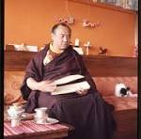
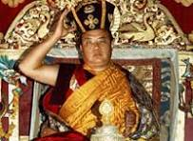
Mahamudra
Mahamudra literally means "great seal" or "great imprint" and refers to the fact that "all phenomena inevitably are stamped by the fact of wisdom and emptiness inseparable“.
thoughts are things
16th Gyalwa Karmapa
Performing Blackhat ceremony
16th Gyalwa Karmapa
Rangjung Rigpe Dorje

Slide 28
Mahamudra
Jamgön Kongtrül the Great Tibetan nonsectarian (Rime) scholar, characterizes mahāmudrā as the path to realizing the "mind as it is“.
For Yogis Going to the Heart
Manifestation and sound arise from the subtle mental imprints created from thoughts. As a picture in water disappears of its own accord, so false appearances automatically fade away when their lack of reality is understood. Beyond essential reality there is nothing – Such is the insight of the Mahamudra.
When the door of the mind, through which appearances are created, remains unobstructed, unwarped by concepts, then there is no solid reality, just bright light, and we let everything that appears just arrive naturally. Such a practice is the meditation of Mahamudra.
Illusory appearances are born of the belief in a reality. Relying on a constant understanding of their non-reality, we dwell at rest in original spontaneous nature and the space where there is nothing to accomplish is thus reached effortlessly. Such is the practice of Mahamudra.
These three points are the treasure of my heart. Since the yogis who go to the heart of everything are like my own heart, for them I have pronounced these heart-felt words, which cannot be communicated to others.
16th Gyalwa Karmapa Rangjung Rigpe Dorje (1924-1981)
The Heart of Mahamudra: A Song of the 16th Gyalwa Karmapa

Slide 29
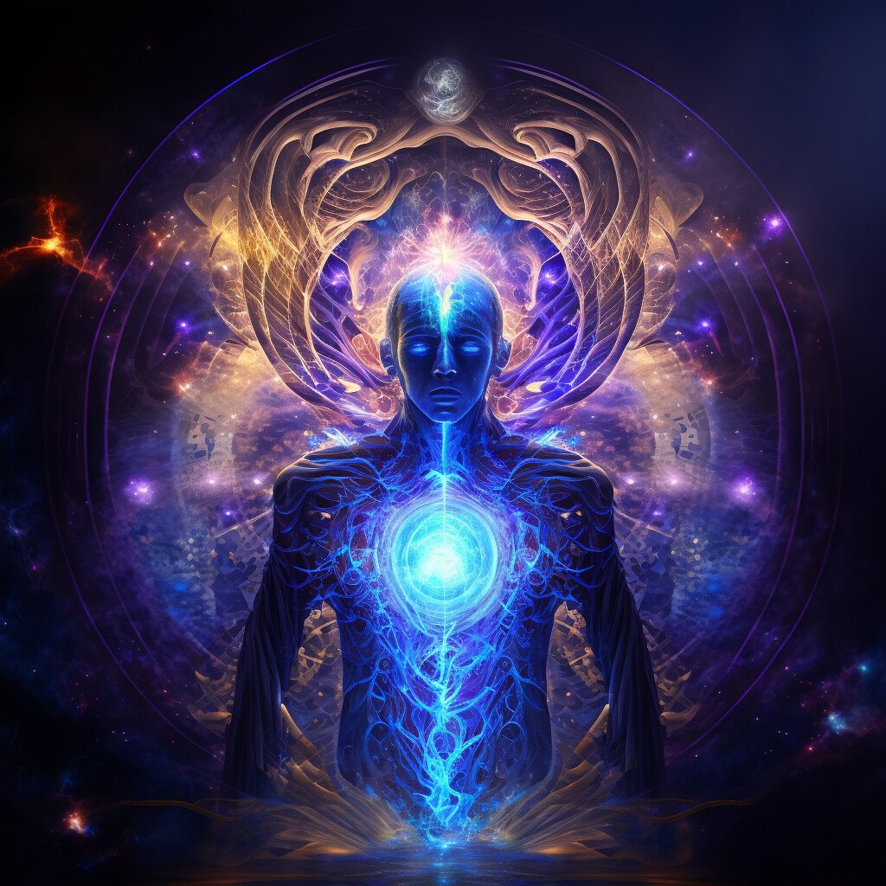
Conclusion

Slide 30
Conclusion
Modern Physics, in particular Quantum Physics,
has shed new light on the nature of reality. It now
appears the basic nature of our reality is an electro
/ magnetic connected world.
In addition, it appears all things in the universe are
connected in such a way as to eliminate time and
space.
Furthermore, this reality seems to be influenced by
our collective consciousness.
Assuming this is true, we now can answer
questions like what is the purpose of life and how
can we heal ourselves.
There are ways to effect our electro / magnetic
bodies available to us today.
The electro / magnetic nature of emotions (wave
frequencies) and the energy centers (Chakras) of
the body has been reviewed.
It appears emotions and energy centers in the
body like chakras, can be controlled to raise
consciousness and promote healing.
It then is not a giant step to infer the purpose of
human life is to raise one’s consciousness, which
will have the effect of providing health, happiness
and a transcendence into a higher realm upon
passing.

Slide 31
References
Caroline Myss https://www.myss.com
Reiki Energy Medicine 1996 Barnett, Babb, Davidson https://www.HealingArtsPress.com
Movie: Mind Walk 1991 Starring Liv Ullman, Sam Waterson, John Heard
Joe Dispenza Becoming Supernatural 2017 Hay House Inc.
Heidi Laber Reiki Master
https://www. Monroeinstitute.org
Non Violent Communication NVC
Dr James Moody Near death experience
Dr Peter Fenwick Neuropsychiatrist Neuropsychologist What Really Happens When you Die You Tube
William and Susan Buhlman Higher Self Now 2016
https://www.therapy-directory.org.uk/memberarticles/the-chakras-and-the-emotions By Timela Garcia Published on 12th October, 2020 | Updated on 23rd February, 2024
12. Samadhi by Mari Silva
13. Nooro https://www.nooro-us.com/
14. https://adwaityoga.com/
15. Coming Home to Lemuria Charmian Redwood
16. Knowledge of Higher Worlds and its Attainment Rudolph Steiner
17. Atlantis and Lemuria Rudolf Steiner

Slide 32
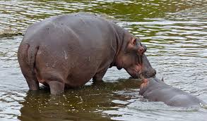
The End

