Slide 1
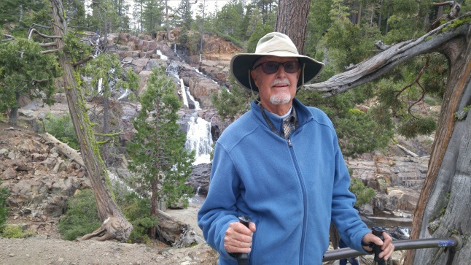
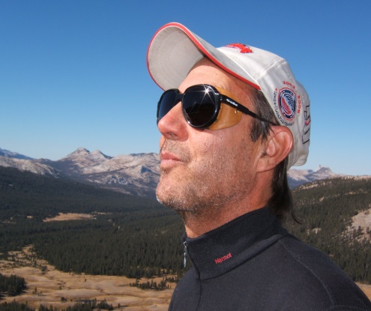
END OF LIFE
Hospice
Presented by John Bohan MS
Based primarily Susan Buhlman’s book
Higher Self Now
Special editing acknowledgement;
Ken Malik & Lori Bochard
John Bohan
Ken Malik
Executive Director

Slide 2
Spiritual Transcendence
Susan Buhlman Bio
Susan Buhlman is a certified End-of-Life Doula and has worked with multiple organizations in providing end-of-life care for hundreds of families.
In this role, she is a companion to the dying and provides spiritual and emotional support to both those who are nearing transition, as well as their families.
She may also serve as liaison to medical, religious, or other parties. In addition, Susan is an educator of the dying process, believing that the transition is made easier by knowing what to expect.
Her hope is for more individuals to experience a more conscious transition.
Visit their website at http://www.astralinfo.org

Slide 3
Spiritual Transcendence
Table of Contents
Process of transition
Stages of dying
Transition Setting
Transitioner
Resolution Questions:
Here are some of the questions I use if the patient is aware, responsive, and in a talking mood
Care Givers
I might ask the family members these questions
What not to do:
Doula
Grief
Visualization
Reiki
Memorial Service

Slide 4
Process of Transition
Stages of Transition
Realization - They are lethargic but still moving. Even if they are bed-ridden there is still some muscle function. This is the time when people begin to talk about events in their life, confirming that their loved ones are in positive situations. They are thanking people for their help, saying ‘I love you’ to friends and family, and maybe showing some emotion when visitors come and go.
Review - One by one, the senses become disabled. Eye movements no longer follow the physical people in the room but they may see people who have previously passed away. At this point they are beginning to free their hold on the physical world. Their spirit is gradually being reintroduced to the astral world to mitigate an abrupt change. This is the one-foot-in / one-foot-out scenario we have heard about from end-of-life professionals. Your presence is still felt, even if not acknowledged.
Release - There is no longer any speech, physical movement, or recognition that anyone is in the room. Affirmations of forgiveness are very meaningful at this time, as the dying will examine some of the perceived ‘mistakes’ that they believe they made.

Slide 5
Setting
In Buddhist philosophy, the space around the dying should be free of all things that would draw attention away from the mission. Items such as photographs and other material possessions can keep the spirit attached to the physical world. This is something to consider as you develop your space.
select an area that is free of excess noise and traffic. You should be able to play soft music and welcome guests.
“As we prepare this space for the sacred transition of our cousin Ben, we ask for God’s blessing. Positive energy and expressions are welcome here. This is a safe and loving place. We invite all of our guides to participate as we celebrate the end of Ben’s earthly journey and the beginning of his transition to the next level of his spiritual evolution. Everything in this space is here to support this profound event.”
The important note here is to keep these items to a minimum. Do not clutter the space or have too many items that would induce the desire to focus on the physical world.
(Unless it is medically necessary, harsh overhead or fluorescent lights should not be a part of the lighting plan.)
Perhaps pure white is the best. Whatever it is, make it right for whoever is dying—not what you think others would like.
The right animal can have a very calming effect on someone who is facing death.

Slide 6
Transitioner
Frequently, people don’t want to leave their transition to chance, hoping someone will know their desires and provide exactly what they need.
We have power even in the end of this life and should do whatever we can to exercise it.
You can document what you would like to have as your last physical environment, right down to the music and lighting.
It is essential to seize the moment and be the masters of our destiny.
We are here on Earth as part of our soul’s education. What better way to use these learnings than in our own transition to the next level?
As most of us do not know how and when we will die, being prepared should be a top priority on our to-do list.

Slide 7
Questions for the transitioner:
Each person has their own timetable for when they are ready to take those last few steps.
Use comforting expressions.
“Let’s use this time to forgive each other for any issues that we have had in this life.
Thank you for being an important part of my life. I appreciate the lessons I have gained from your role in it. Your life has been a gift to us all.
Now is the time to forgive those who have given you challenges. Now is the time to accept forgiveness from those who have challenged you.
Now is the time to say goodbye, with a heartfelt thank you from all you have served in this life. We wish for you to have a peaceful journey as you transition to your higher self.”
“I understand it may be time for you to leave us. I support your decisions. You will always be in our hearts as you move to a higher place.”
The greatest gift is to simply be there to support their journey. So take your ego out of the room and let love take its place.
When you feel that your loved one has begun to withdraw, respect (don’t correct) that choice of behavior.

Slide 8
Questions for the transitioner:
Here are some of the questions I use if the patient is aware, responsive, and in a talking mood:
“How did you two meet?” (This is in reference to a photo of a spouse or partner.)
“Have you traveled anywhere special?”
“Tell me about this photo/your children/the handmade quilt on your bed.”
“What was your first car like?”
“What was your first job?”
“Did you grow up in this area? Tell me about other places you have lived.”
“What changes have you seen in the last 10/20/30 years that have impressed you the most?

Slide 9
Care Giver
When you feel that your loved one has begun to withdraw, respect (don’t correct) that choice of behavior.
Enter the room with a relaxed but caring attitude. It is OK to shed a few tears during your visit, but if you feel a fit of hysteria coming on, you should probably excuse yourself until you can pull it together.
Am I being authentic?
Am I being calm?
Am I being caring?
I have always felt it to be an honor to be a part of someone’s transition. This is by far the most important endeavor of this lifetime and they are allowing me to share it with them.

Slide 10
Care Giver
I might ask the family members these questions:
If the patient is sleeping, but listening, I might ask the family members these questions, always being aware that the loved one can likely hear the conversation:
“What was your grandmother’s life like? Was she a good cook?”
“What is your favorite holiday memory?”
“What is the most important lesson you have learned from your mother?”
“What do you remember most about your childhood?”
“Did you have any adventures with your brother when you were kids?”
“What is your sister’s favorite hobby/ TV show/movie?”

Slide 11
Care Giver
What not to do:
People talking about the patient as though they were not in the room.
Withholding pain medication for fear of addiction or desertion.
Keeping the TV or radio on for diversion.
Displaying religious items that were not a recent part of their life.
Feeding the terminal patient after the medical team has advised against it.
Overstimulating someone with a constant stream of visitors, unrelated chit-chat, and/or unnecessary noises.
Encouraging the patient to fight a terminal disease.
Loud crying, lamenting, or otherwise creating an environment of heavy grief.
Clutter in the sacred space.

Slide 12
Care Giver
What not to do:
Yes, I understand that people don’t know what to say, but I cannot emphasize enough that just because a person appears to be unconscious, THEY CAN STILL HEAR YOU!!
Making comments that refer to a funeral home, burial, or memorial service while a person is dying might re-direct their thoughts from a peaceful and spiritual transition to a physical event that could arouse fear.
Supportive affirmations can be recorded and played softly in the background.
Our quiet presence is sometimes the most valuable gift we can give.
Crying, sobbing or lamenting in a disruptive way will interfere with the soul who is trying to separate.

Slide 13
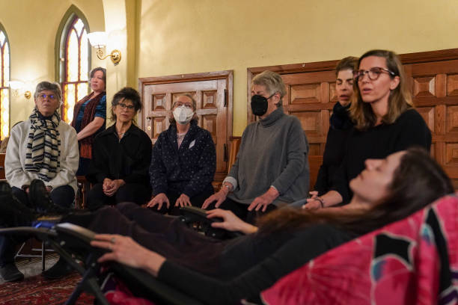
Doula
A guide for the dying
The primary purpose of a doula is to provide comfort and companionship to the dying, but they can also be a liaison between the family and the medical team if required.
A doula can have a calming presence during an emotionally charged time.
one of the most important functions of an end-of-life coach is to provide emotional (and sometimes spiritual) support to the dying.
A doula can educate the uninformed about the dying process to remove the negative emotions associated with uncertainty. Then the family can focus on unconditional love and in doing so the overall vibration will increase.
Maintain respect for the dying as this is the ultimate support role. People will die when they are ready and not a moment before. There are a number of stories suggesting that many of the dying will wait until they are alone to take their final breath.

Slide 14
Doula
A guide for the dying
Another crucial skill is to be nonjudgmental. Between family dramas, religious preferences, cultural practices, and even economic situations, you are likely to find yourself in the middle of things you don’t understand or agree with.
Again, this requires respect for the dying.
Your role is to be a neutral and calming influence. To do this, you must remain composed and not join in the controversial discussions that may pop up.
The most important attribute of a successful doula is the ability to make the family feel at ease.
No matter what might be happening in your life, the most important thing is to focus on the person who is in transition.

Slide 15
Grief
You might feel afraid of the new responsibilities that you have inherited.
If you know nothing about the home finances because your wife always took care of the checkbook, then you have to learn this new process right in the middle of mourning your loss.
Emotionally you could feel abandoned by a person who had pledged to be by your side for the long term and now they are gone— possibly without warning.
Acknowledge the spiritual truth. We are spiritual beings having a human experience. Our body is merely a tool to move us around this earth in order for us to complete our human education.
They are convenient trappings that we are using to gain experience and learn about Earth life’s challenges.
Although we have some control or forethought about our own end, we cannot control or predict the death of another.

Slide 16
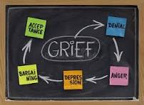
Grief
It is important to remember that once the physical body has ceased to function, the soul (or spirit) that inhabited that body may still be present. We can assist that spirit to move on to the dimension that is right for their spiritual development. How we grieve and the type of farewell ceremony we design can have an impact on their ability to move on.
From before we are born, we know that we are here for only a finite amount of time. Maybe it is 97 minutes, maybe it is 97 years—but we know when we come here that we will someday dispose of the physical body that no longer serves us. Although we have some control or forethought about our own end, we cannot control or predict the death of another.

Slide 17
Visualization

Slide 18
Visualization
Crossing the Bridge You are lying down because you are very tired. It is a little chilly and your muscles are achy.
Your eyelids are very heavy and all you want to do is sleep.
But something in the distance is calling you. You can barely hear it; voices are calling your name. Even though you are tired, you decide to get up and follow the sounds.
You rise from your bed and begin with a few small steps. A path becomes clear so you start to walk along the trail. Your legs are heavy, but with each step the music becomes louder and you are very curious about it. Step by step, you begin to feel more energy.
You continue down the path and your muscles are becoming stronger and stronger. You feel yourself moving a little bit faster now.
The chill is gone and you are warm, full of energy. In the distance there is a golden glow. You can’t stop looking at it, and you walk faster toward this beautiful, radiant warmth.
The voices are becoming louder, as you hear your name being called again.

Slide 19
Visualization
The music is becoming clear now, and there is laughter. You are walking faster and faster down the path as your energy continues to increase. You are lighter and lighter, with no cares, no worries.
As you continue on the path, it becomes clear that there is a bridge you must cross to reach the music and people. This is the bridge that will connect you to your higher self.
You slow down, hesitate. The bridge crosses an abyss and you can’t see the bottom. Somehow you know that once you go over the bridge, there will be no turning back.
The music continues, your name is called again, and you decide to complete your journey.
Your pace picks back up and you walk briskly onto the bridge. You are so light that you can barely feel your feet hit the ground. You are halfway across and you know you have made the right decision.
There are faces on the other side that you recognize. The laughter and music are louder, people are dancing.
As you finish crossing, the golden glow surrounds you, warms you to the bone. You are so comfortable. You know you have reached a place of love and peace; your higher self has returned home.

Slide 20
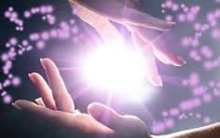
REIKI

Slide 21
REIKI
“As soon as Reiki is activated, its high frequencies of energy immediately begin to raise our vibration, activate our spiritual guidance and increase our life force energy.”
I start with introductions and a request for permission to be there. Gratitude is always part of my introduction as I thank the patient and/or family for inviting me to be a part of this significant time in their life. This is heartfelt, because I truly feel blessed to be included in this event. It is a gift to me.
“Hello, Sarina. My name is Susan and I am here to help you relax and send some healing energy to you. First, I would like to thank you and your family for allowing me to be a part of this incredible journey that you are taking. If it is OK with you, I would now like to invite my Reiki guides to support us. And anyone in the room who is here for Sarina, please assist me in bringing light and peace to this beautiful soul.”
At this point I begin moving around the bed and placing my hands wherever I can reach or where I feel that the warmth is needed.
Just for today:
​I will not be angry
I will not worry
​I will give thanks for my many blessings
​I will do my work honestly
​I will be kind to my neighbor and every living thing

Slide 22
Closing Ceremony :
A closing ceremony can be beneficial for both the recently transitioned and the supporting participants.
It directs the soul to move on to the next level and it provides a structured opportunity for goodbyes. Some people are more comfortable with a group ceremony than an individual farewell. If it is possible, do this before the body is moved. With close friends and family participating, this can be a very intimate and memorable gathering.
First, create a healing circle around the bed. Have each person hold a light. This should be a candle if you can do it safely. If not, then use some kind of battery-operated, hand-held lighting.
If you accept the truth that the soul is separate and has only used the physical body for transportation, it will make much more sense to let their spirit soar.
If appreciated, a more formal Memorial Service can also be created.

Slide 23
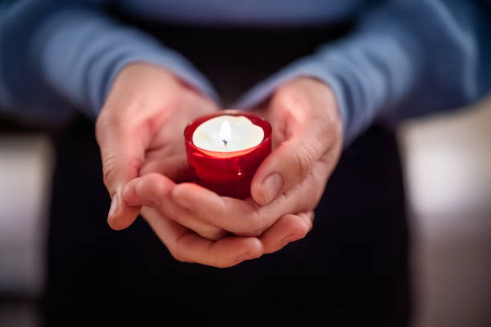
Memorial Service :
What is a home funeral? This is a do-it-yourself service where family and friends gather and participate at home (or other sacred space) to say goodbye to a deceased friend or family member.
Don’t feel like you have to plan the whole thing yourself. If you are grieving, there is enough on your plate. All those friends who have been asking what they could do to help would be more than happy to pitch in and check on chair rentals, create custom music collections, or set up parking arrangements. There are also professional event planners that can assist.
Music and atmosphere
Words and verse
Bouquet of Life – Ask each participant to bring a single-stemmed flower that best reminds them of the deceased. During the ceremony, ask each person to place their flower in the vase.
Life Light Candles deceased. At some point, have each person take a tapered candle from a stack and light their candle from the main flame.
The Hindus believe that prolonged grieving can hold the soul in earthly consciousness, inhibiting their full transition.

Slide 24
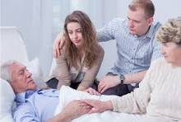
Memorial Service :
two beneficiaries in a ceremony honoring a life that has ended.
The first is to provide a ritual that that allows the living to say goodbye. It should include sights and sounds that celebrate the life and mission of the deceased. It is a forum for those who have had meaningful relationships to honor that relationship and say goodbye.
The second is to release the soul who may still be lingering. With words and actions, in our role as physical beings, we can demonstrate to those who have passed that the time has come for them to move on. P256
When you feel that your loved one has begun to withdraw, respect (don’t correct) that choice of behavior.
Water - Place a tabletop water feature in the room to add the soothing sounds of water falling. •​Have a bowl of water in the room with floating flowers or candles.
Provide a blessing for the Transiitoner in the room.
Provide incense and or flowers to enhance the atmosphere (Just be sensitive to any smell that might be overwhelming.)

Slide 25
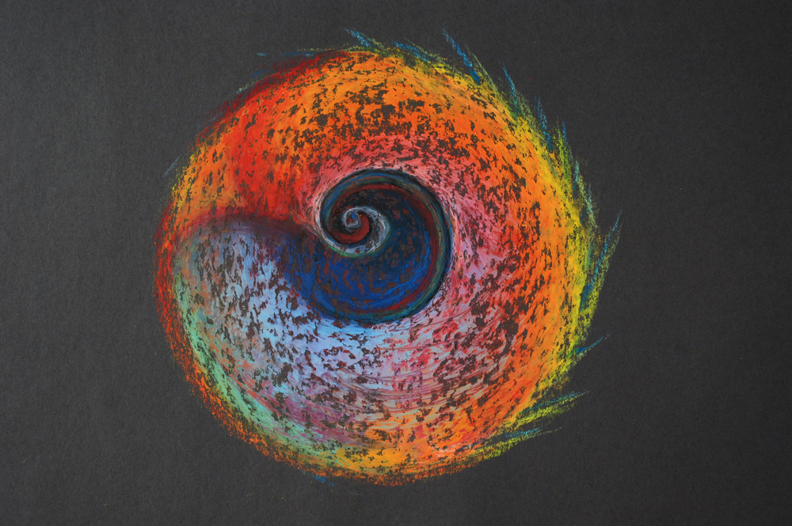
Memorial Service :
Active:
​Toast the dying. In a circle (if there are many people) or as a single participant, share a happy memory and raise your glass to honor the life of the person.
​Bathe the feet and hands of the dying with warm water and a gentle cloth. Wipe the face, neck, and shoulders with a loving caress. It can be very unsettling to be without the comfort of a hot shower one used to enjoy.
Create a soul circle. Each person can hold a small glass of warm water and empty it into a bowl as they make a statement of gratitude. You could then use that water for cleansing as a symbol of a single caring act.
As with all activity in the sacred space, make it special. Make it an act of love and give it the respect that your cherished one deserves.
Music - There are some great commercially produced sound tracks available, but if you don’t have any meaningful meditations or affirmations to play, then I suggest you play soft music only and recite those affirming comments yourself.

Slide 26
References
William and Susan Buhlman Higher Self Now 2016
Sebastian Junger In My Time Of Dying
Living and Dying Workshop https://www.livingdying.org/online-course/
Caroline Myss https://www.myss.com
Reiki Energy Medicine 1996 Barnett, Babb, Davidson https://www.HealingArtsPress.com
Movie: Mind Walk 1991 Starring Liv Ullman, Sam Waterson, John Heard
Joe Dispenza Becoming Supernatural 2017 Hay House Inc.
Heidi Laber Reiki Master
https://www. Monroeinstitute.org
In My Time Of Dying Sebastian Junger
Dr James Moody Near death experience
Dr Peter Fenwick Neuropsychiatrist Neuropsychologist What Really Happens When you Die You Tube
Samadhi by Mari Silva
Knowledge of Higher Worlds and its Attainment Rudolph Steiner
Atlantis and Lemuria Rudolf Steiner
https://www.livingdying.org/online-course/
17. Quantum Body Depok Chopra

Slide 27
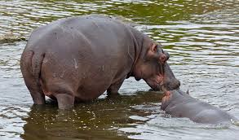
The End

